Slide 1

Introduction to Data Science
Association of Data Science

Slide 2
What is Data Science?
Why is it important?
  Data science is an interdisciplinary field that combines statistical analysis, programming, and domain expertise to extract insights and knowledge from data.
  It involves a process of collecting, cleaning, analyzing, and interpreting data to inform decision-making, solve complex problems, and predict future trends.
  By applying various techniques such as machine learning, data mining, and data visualization, data scientists can uncover patterns and relationships within data that would otherwise remain unknown.
Data science is crucial in today's world because of the vast amounts of data generated every day.
Allows organizations to make data-driven decisions, optimize operations, and gain a competitive edge.
In business, data science can enhance customer experiences, streamline processes, and boost profitability.
In healthcare, it can lead to better patient outcomes through predictive diagnostics and personalized treatments.
In finance, it helps manage risks and detect fraud.
Essentially, data science transforms raw data into actionable insights, making it a key driver of innovation and efficiency across many industries.

Slide 3
The Data Science Process
Steps:
  Data Collection: Gather relevant data from various sources.
  Data Cleaning: Prepare data for analysis (removing inconsistencies, formatting errors, etc.)
  Data Exploration: Identify patterns and insights (using SAS, Python, etc.)
    Descriptive Statistics (mean, median, mode, standard deviation, IQR etc.)
    Visual Exploration: Use histograms, box plots, and scatter plots to identify trends, patterns, and relationships.
    Correlation Analysis: Determine the relationships between variables.
Outcome: Formulate hypotheses and guide further analysis…

Slide 4
The Data Science Process (continued)
Further Steps:
  Modeling: Apply statistical and machine learning techniques to make predictions or classifications.
    Types of Models:
    Supervised Learning: Regression (e.g., linear regression) and classification (e.g., decision trees).
    Unsupervised Learning: Clustering (e.g., k-means)
  Deployment: Implement solutions in an environment to make it accessible for use.
    API Integration: Deploy the model via an API for real-time predictions.
    Batch Processing: Apply the model to large datasets periodically.
    Cloud Deployment: Host models on cloud platforms for scalability.
  Monitoring and Maintenance: Regularly check model performance and update as needed to ensure accuracy over time.
  Visualization: Communicate the results in a clear and understandable manner.
    Tools:
    Tableau, Power BI: Creating interactive dashboards.
    Matplotlib, Seaborn: Plotting in Python for custom visualizations.

Slide 5
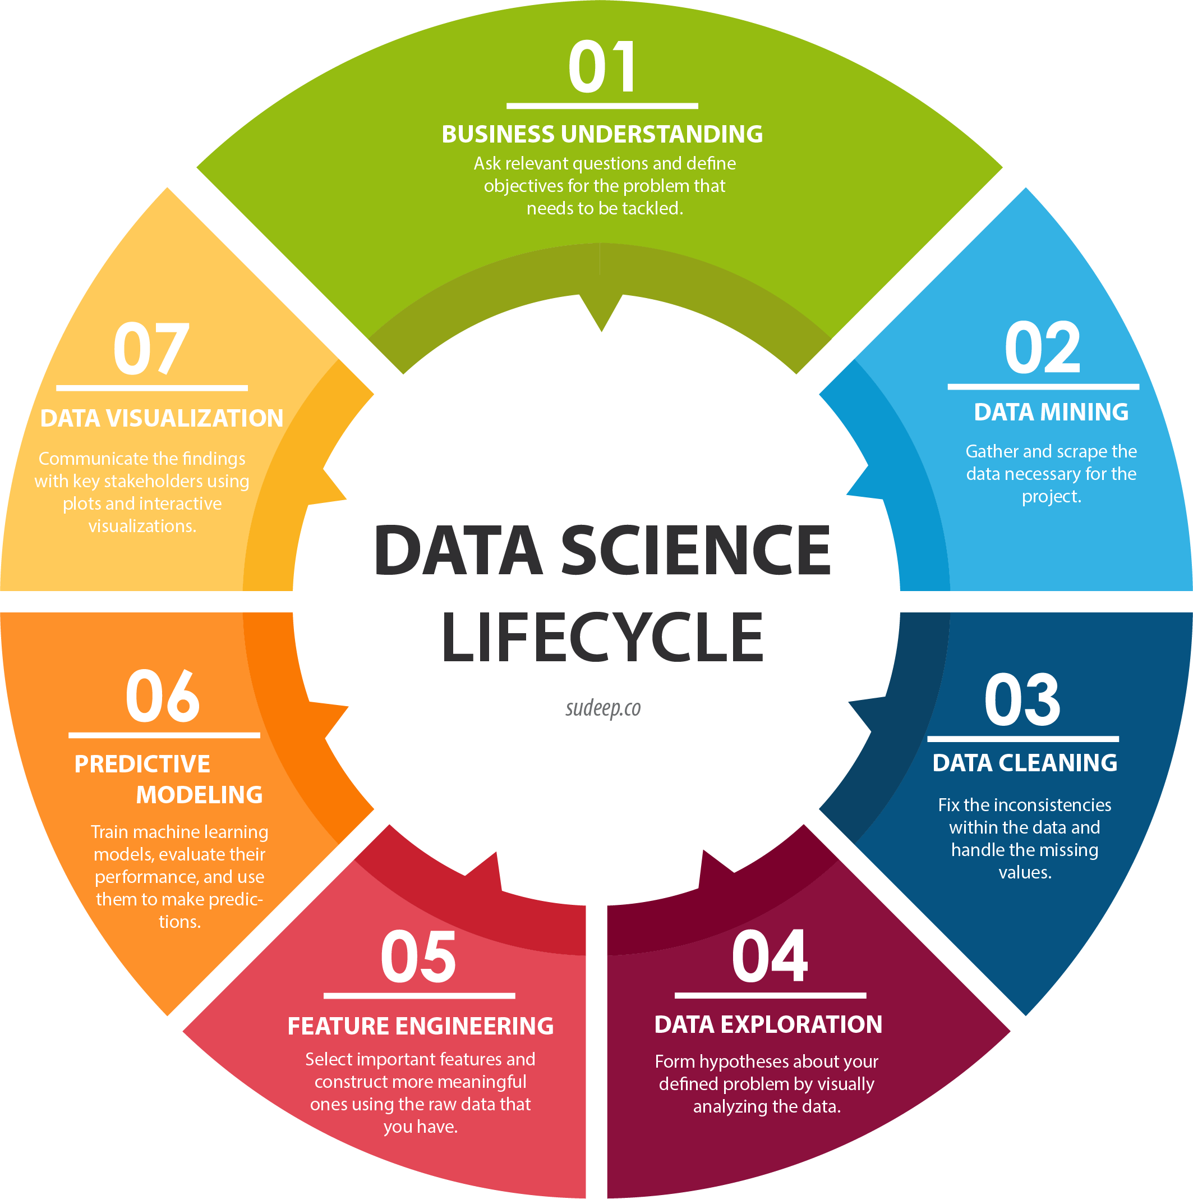

Slide 6
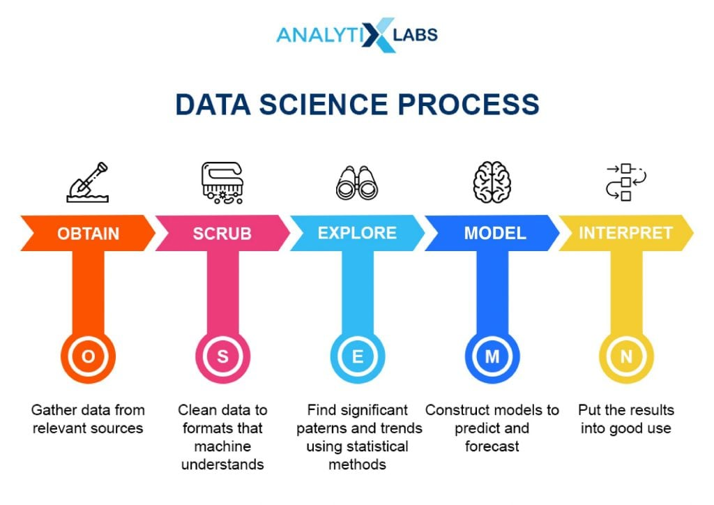

Slide 7

Semester-kickoff Questionnaire

Slide 8


Connect with us! Discord:
Instagram: @clt_ads
Linktree: https://linktr.ee/clt_ads?utm_source=linktree_profile_share
GitHub: https://github.com/DylanABenson24/UNCC_Data-Science_Association
SDS Resources:
https://sds.charlotte.edu/
https://sds.charlotte.edu/upcoming-events/

